Slide 1


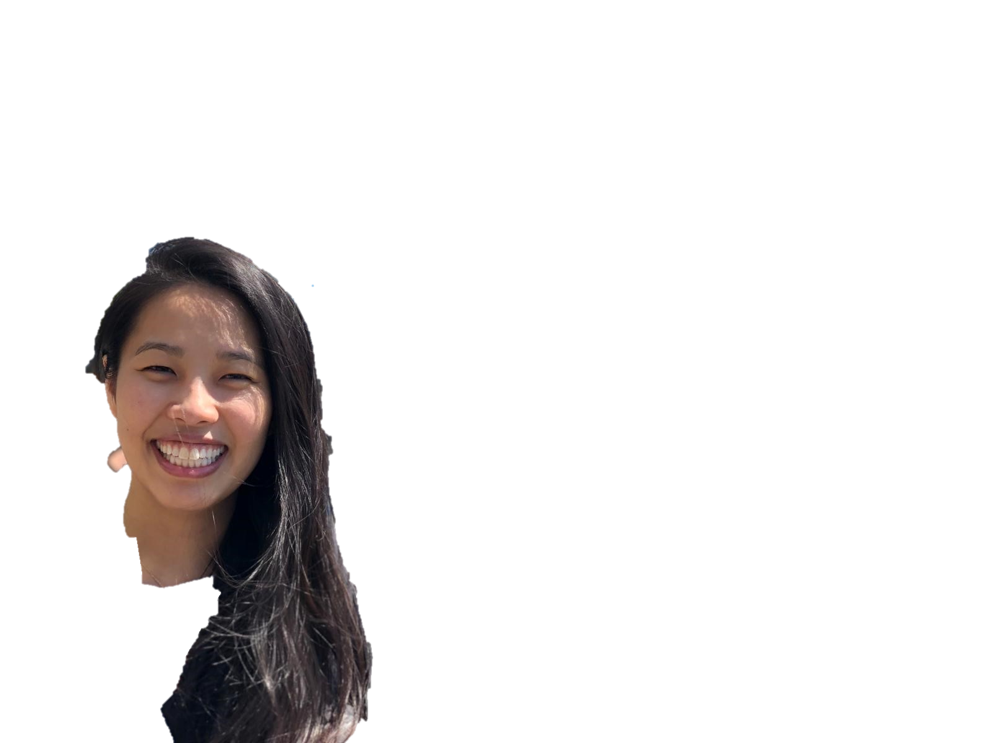
KARUNAKARAN SATHAMBAKKAM
JENNIFER TSANG
AND
Menu Manager (MVP)

Slide 2
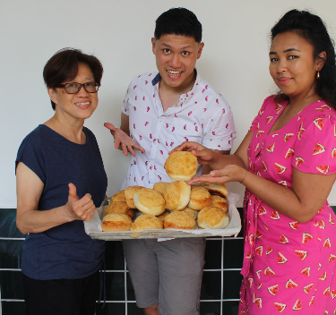

Our Inspiration
Target Audience:
New, small business restaurant owners
Meet Laurence!
Source: https://www.rubato-food.com/about-us

Slide 3
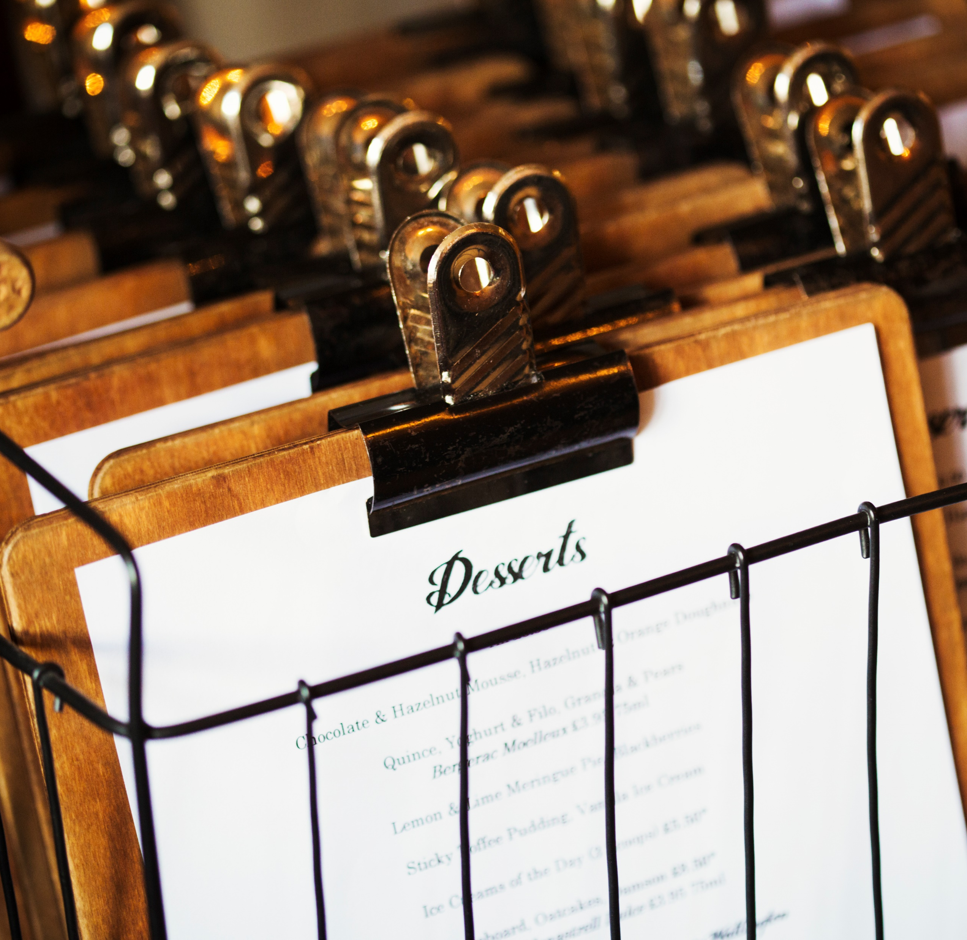

Problem
Manual
Time Consuming
Notes:
Jen

Slide 4
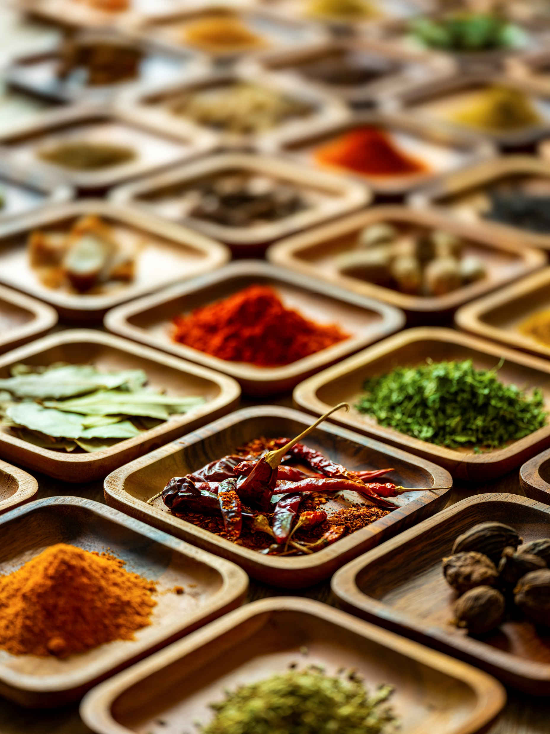




Busy restaurant owners can seamlessly edit constantly changing menu items
Solution

Slide 5

Live Demo
Live Demo

Slide 6







Technologies
Notes:
Karunakaran

Slide 7
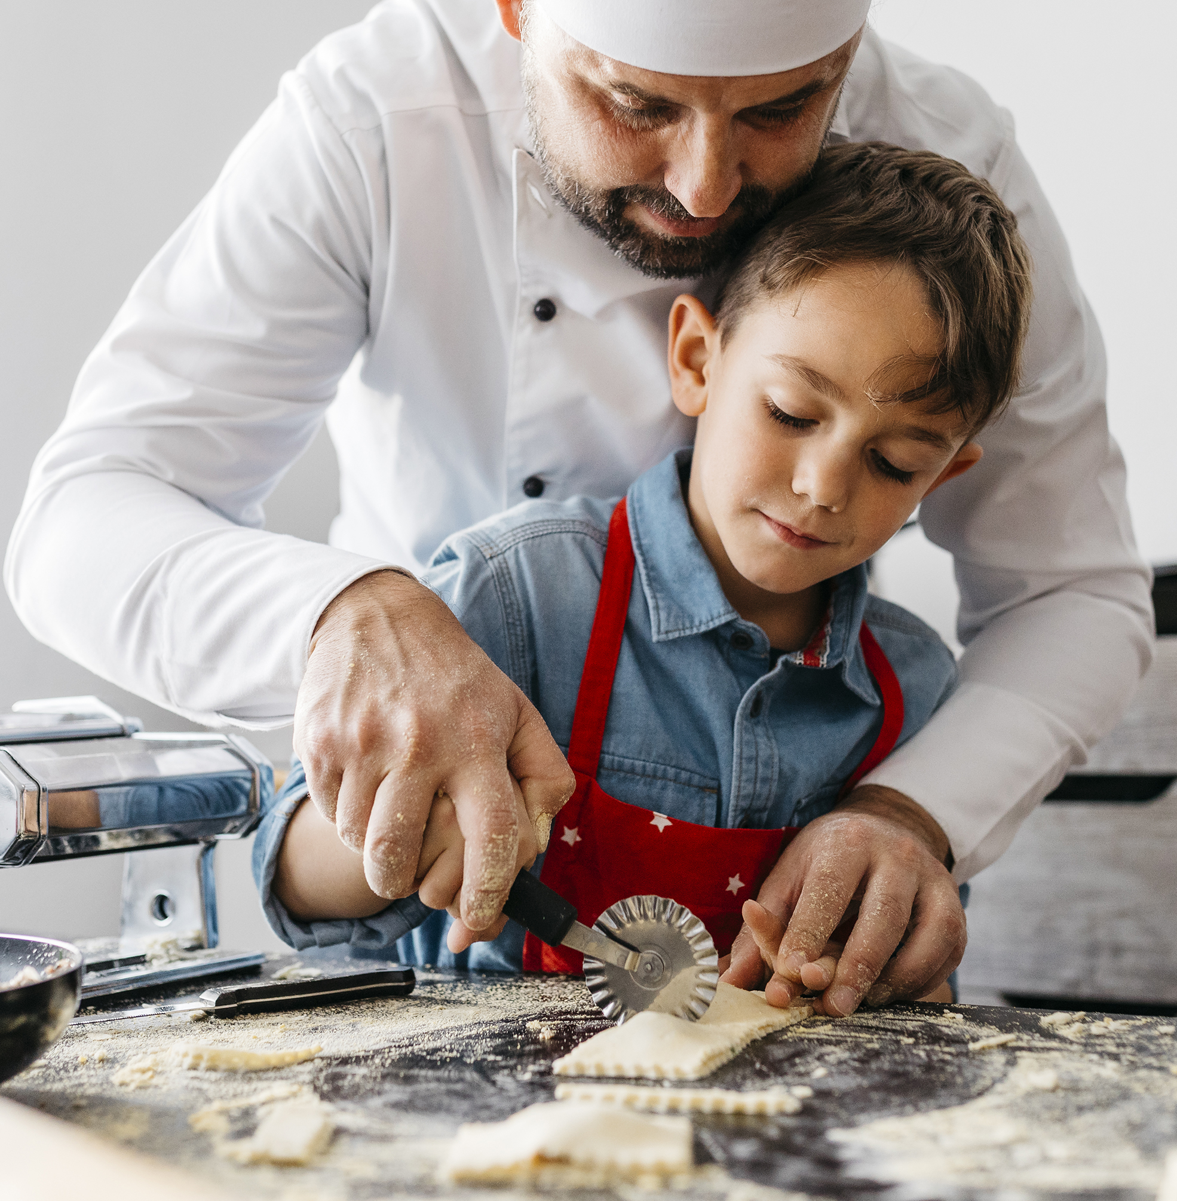
Learnings & Challenges
UI Design
Prioritization of Features
Front <> Backend
Database Management
Notes:
Karunakaran
-UI Design: refresh & beef up our knowledge in CSS
-We were already familiar with building a frontend of an app, but for this app, we needed to learn how to create and integrate the backend with the frontend
-Learning how to store and update data in a database
-Prioritization of Features – constantly revisiting what we felt we were able to deliver in the MVP for the deadline
-Deployment

Slide 8
Future Features
Owners can…
review changes before submitting
archive deleted menu items
create a backlog of ideas
Customers can…
order from this app
Notes:
Karunakaran
-UI Design: refresh & beef up our knowledge in CSS
-We were already familiar with building a frontend of an app, but for this app, we needed to learn how to create and integrate the backend with the frontend
-Learning how to store and update data in a database
-Prioritization of Features – constantly revisiting what we felt we were able to deliver in the MVP for the deadline
-Deployment

Slide 9


KARUNAKARAN SATHAMBAKKAM
JENNIFER TSANG
KARUNAKARAN SATHAMBAKKAM
JENNIFER TSANG
AND
AND
Thank you!
Coming soon!

